Slide 1


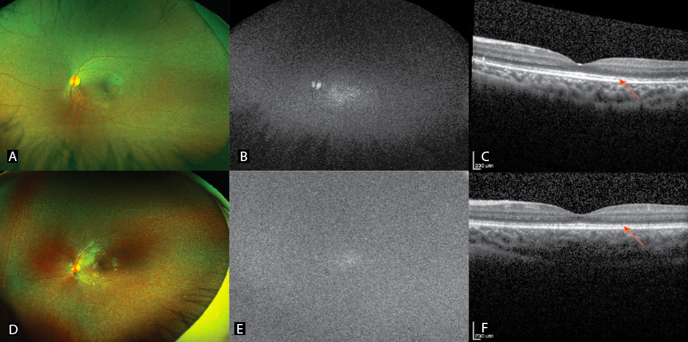
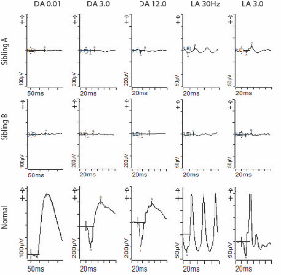
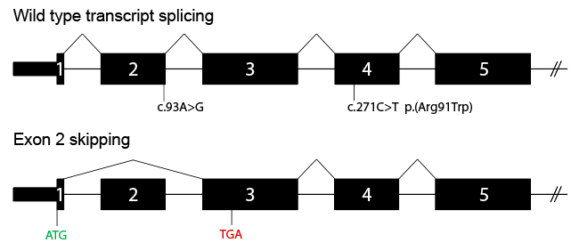
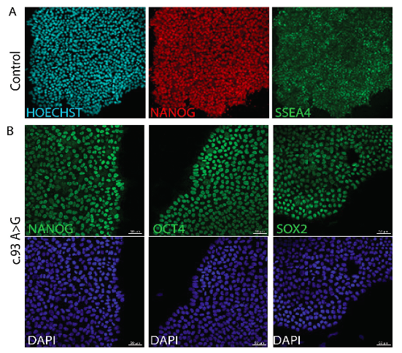
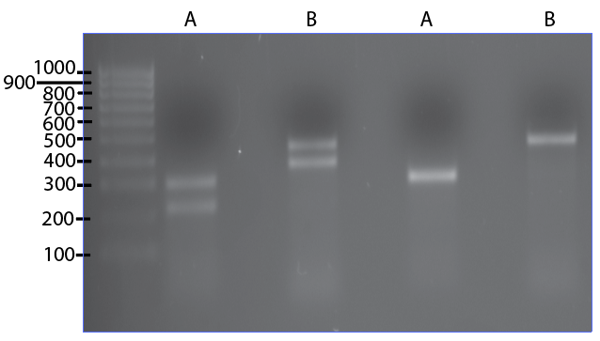
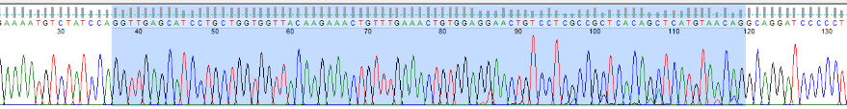
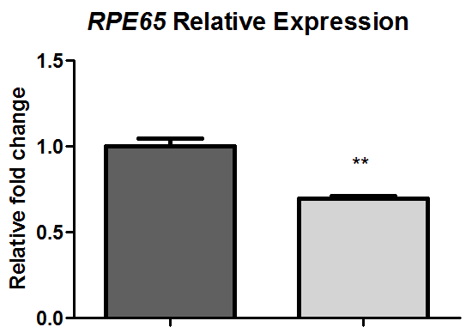
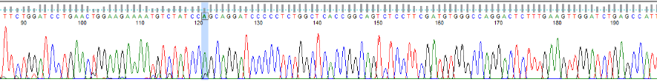



RPE65 synonymous variant causes aberrant splicing in patient-derived iPSC-retinal pigment epithelial cells
Benjamin M. Nash^{1,2,3*}, To Ha Loi¹, Amin Sabri¹, Steven Eamegdool¹, Milan Fernando⁴, John Grigg¹, Seo-Kyung Chung^{5,6}, Anai Gonzalez Cordero⁴ and Robyn Jamieson ^{1,2,7}
1. Eye Genetics Research Unit, Children’s Medical Research Institute, Sydney Children’s Hospitals Network, Save Sight Institute, University of Sydney, Westmead, Sydney NSW; 2. Specialty of Genomic Medicine, Children’s Hospital at Westmead Clinical School, Faculty of Medicine and Health, University of Sydney, Sydney NSW; 3. Sydney Genome Diagnostics, Western Sydney Genetics Program, Sydney Children’s Hospitals Network, Sydney NSW; 4. Stem Cell Medicine Group, Children’s Medical Research Institute, University of Sydney, Sydney NSW; 5. Translational Neurogenomics Group, Kids Research, Sydney Children’s Hospital Network, Sydney NSW,; 6. Brain and Mind Centre, Faculty of Medicine and Health, University of Sydney, Sydney NSW; 7. Department of Clinical Genetics, Western Sydney Genetics Program, Sydney Children’s Hospitals Network, Sydney NSW
Study Background
Inherited Retinal Dystrophy (IRD) describes degenerative disorders of the retina with a prevalence estimate of 1:1000 people. Vision impairment varies from poor peripheral or night vision to complete blindness, and severity usually increases with age. Genomic studies examining the >250 IRD-associated disease genes are providing molecular diagnosis in ~50% of families examined. However, variant curation can often be challenging when assessing novel genomic variants. This is especially relevant with the strict inclusion criteria for gene therapy, such as voretigene neparvovec recently approved for use in Australia for retinal dystrophy due to RPE65 mutations. Patient-derived retinal pigmented epithelial (iPSC-RPE) cells provide a valuable resource for investigation of genes with retinal-specific expression.
This study determines the pathogenicity of a novel synonymous RPE65 variant of unknown significance detected in trans with an established pathogenic variant on diagnostic genomic testing, in siblings with early onset retinal degeneration.
Ophthalmic & clinical genomic investigations
Proband presentation at 4 years & sibling at 2 years
Flecked macular appearance [pictured near right]
Electroretinogram showed extinguished rod-cone function from 5 years [pictured, far right]
Optical Coherence Tomography (OCT) showed preserved photoreceptors within the macula
Clinical diagnosis → Early-Onset Severe Retinal Dystrophy (EOSRD)
Heterozygous RPE65: p.(Arg91Trp) – classified as Pathogenic
Most commonly reported pathogenic variant in literature
Heterozygous RPE65: p.(Thr31Thr) – classified as VOUS
- Novel synonomous substitution
Absent from gnomAD (v2.1.1), ClinVar, LOVD and HGMD
Impacts penultimate 3’ nucleotide of exon 2
Predicted reduced effect of natural splicing at canonical donor site
- Segregation studies showed the variants were in trans, with heterozygous biparental carriers
Sibling - 1
Sibling - 1
Sibling - 2
Sibling - 2
RPE65 wild type transcript splicing
Normal
VOUS
*
Pathogenic variant
Parental p.(Thr31Thr) carrier hiPSC-RPE differentiation
+
Identifiable hiPSCs manually
isolated and expanded
E6 + Proneural media,
Emerging RPE islands visible
RPE islands manually isolated and grown in monolayer cultures
Isolate PBMCs
Nucleofect PBMCs with transcription factors L-MYC, LIN28, SOX2, KLF4, and OCT3/4
Control
Further characterization:
Tri-lineage differentiation
SNP array analysis
iPSC differentiation to retinal cells:
RPE marker expression
Parental p.(Thr31Thr) carrier
RNA studies of hiPSC-RPE cells demonstrate aberrant splicing & sensitivity to Nonsense Mediated Decay
RPE65(NM_000329.3)
(bp)
RPE65: wild type allele
~30% reduction in heterozygous carrier
Exon 1
Exon 2
Exon 3
- Mutant allele
A
B
RPE65: mutant allele
*
Parental carrier hiPSC-RPE
Control
hiPSC-RPE
5’ UTR
Exon 1
Exon 3
Control hiPSC-RPE
Parental carrier hiPSC-RPE
Orthogonal HEK293-based minigene assay confirms exon skipping
Wild type RPE65 allele: 533 amino acids
Predicted RPE65 mutant allele: 22 amino acids
n=3; P ≤ 0.01
NH₂-
-COOH
NH₂-
Conclusions
The generation of a hiPSC-RPE model facilitated access to RPE65 RNA, showing skipping of exon 2 and sensitivity to NMD
hiPSC-RPE model enabled reclassification of the genomic variant to Pathogenic, and confirmed eligibility for gene therapy
This study showcases the importance of synergistic stem cell studies and diagnostic genomics in the era of gene therapies
CONTACT ME

